Slide 1
Week 01, Day 01
Getting Started
CodeSLO 2018

Slide 2
Welcome!
Welcome to the CodeSLO Beginning Web Development Course, 2018.
Whether you’re here to start a career in software development or to enhance an existing career in IT or software testing, you are in for a fun, challenging class.
Let’s get started.

Slide 3
About this course
Course Length | Eight Weeks (72 Hours total)
Class Days | M, T, W, Th
Class Times | 5:30pm - 7:30pm
Hackathon Day | Saturday, August 25th 9am - 7pm
Last Day of Class | Friday, September 7th, 2018
Holidays (no class) | Monday, September 3rd (Labor Day)

Slide 4
The purpose of this course
The purpose of this course is to guide students from a point of zero or very little knowledge in web development to a point where they have a solid, beginner-level understanding of the core technologies of web development: HTML, CSS and JavaScript.
The primary focus of this class will be on the JavaScript programming language.
Our goal at the end of the course is to take and pass the admittance exam for the Fullstack Academy Coding Boot Camp. Even if you don’t intend to attend that camp, the test will help us (and you) gauge your skill as a programmer.

Slide 5
About SLO Partners
SLO Partners was formed under the aegis of the San Luis Obispo County Office of Education in 2014 to address college and career readiness among the county’s student population.
SLO Partners’ mission is to engage business partners and educators in aligning workforce needs with career and college pathways and provide work experience opportunities to ensure that students have the skills and knowledge necessary for success in the workplace.
SLO Partners is committed to collaborating with local businesses and education to find pathways to opportunity for local talent.

Slide 6
About CodeSLO
CodeSLO, LLC is a company that offers software development classes for Central Coast residents.
CodeSLO started out as a community coding school in 2014 and has grown to over 800 members. We’re sponsored by local tech leaders and we’ve worked with organizations such as Cal Poly, WISH, and the SLO County Office of Education.
CodeSLO and its classes have been covered by the SLO Tribune, SLO Life Magazine, New Times, KSBY and others.
CodeSLO’s mentors are all professional software developers, many of whom volunteer their time. Our classes would not be possible without them.

Slide 7
Introductions
We’re going to be spending a lot of time together over the next eight-weeks.
Many of the people in this class will be your peers as you advance in your software development career.
Let’s get to know each other a little bit.

Slide 8
Your Mentors
Meet the instructors for this course!

Slide 9
A Present from Fullstack Academy
Fullstack Academy has a podcast made for those breaking into software development (that’s you!)
iPhone: https://itunes.apple.com/us/podcast/techd-out/id1375045443?mt=2
Android: https://www.stitcher.com/podcast/techdout/techd-out
On my Android phone, I got this working by installing the Sticher app, then searching for the techd-out podcast.

Slide 10
Logistics
Where to park
Facilities
WiFi Connectivity
When we’ll take breaks

Slide 11
Attendance
We’ll be tracking attendance with a custom application.
If, on the last day of class, you have 90% attendance or better, your deposit will be refunded in full, minus a small surcharge.
You can find our attendance-tracking app at https://codeslo-attendance.herokuapp.com

Slide 12
Just show up? That’s it?
Well, we do ask that you take the Fullstack Admittance exam, but passing the test is not a requirement for getting your deposit back.
It is our sincere hope that everyone gets their deposit back.
We’re not here to keep your $399. We’re here to help people start careers in software development.

Slide 13
Expectations
Classes will start on time
Course mentors will conduct themselves as the professionals they are
We expect the same conduct from everyone here.
We have a “no jerk” rule. Treat everyone as you would like to be treated.
No hostility, no drama.
Peace, love, and code.
Classes will be challenging. Come ready to work.

Slide 14
Learning to code is hard… and that’s okay.
The challenge you’ve accepted is not an easy one. Learning to code is hard.
You’re going to get stuck.
You’re going to feel frustrated.
You’re going to feel like you’re not smart enough to do this.
These are all normal feelings. It’s okay to feel them.
Remember… if coding were easy it wouldn’t pay so well!

Slide 15
Tenacity is Talent

Slide 16

Ready to take the leap?

Slide 17
Break
… Back in five

Slide 18
Getting Started

Slide 19
How the Web Works
It all starts with the browser
The browser is a program that runs on the client computer
The client computer delivers information stored on a web server to the browser
Files and data are transferred between the client and server via HTTP or HTTPS
Servers deliver HTML, CSS, JavaScript, and data formats such as JSON.

Slide 20
Client and Server, Front-end and Back-end
The client computer is the one that hosts the web browser. Right now, all of us are sitting in front of client computers. Programming for the client is considered front-end development.
The server is the computer that hosts the HTML, CSS, and JavaScript files. The server also communicates with a database in more complex applications. Programming for the server is called back-end development.
Clients and servers communicate using HTTP.

Slide 21
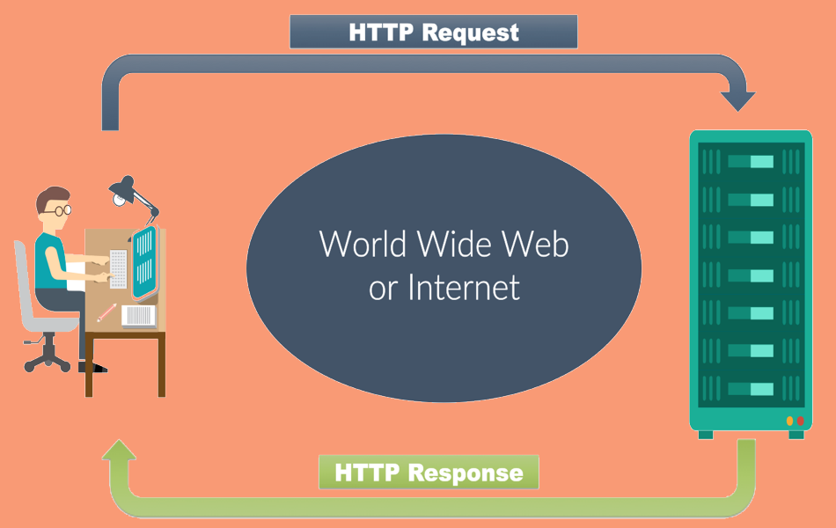

Slide 22
What web developers do
Web Developers primarily work with three technologies, HTML, CSS, and JavaScript.
HTML defines the content of a web page, such as text and images.
CSS defines the appearance of that content. It’s a styling language.
JavaScript is the programming language of the web. It defines the functionality of a site or application.

Slide 23
HTML
HTML is a markup language. It was the first web technology invented and was originally used for creating scientific and engineering papers that could be easily shared over a network. It was developed at CERN.
HTML (Hypertext MarkUp Language) is fairly easy to learn. We’ll work with it today.

Slide 24
CSS
CSS is the styling language of the web. It is a powerful tool that can give a web page pretty much any appearance you’d want.
CSS came later in the history of the web. Without it the Internet would be an ugly place.
CSS is more complex that HTML. We’ll get a chance to work with it today.

Slide 25
JavaScript
JavaScript is the programming language of the web. It is the only programming language that browsers can currently understand (WebAssembly aside, for those who have heard the rumors.)
JavaScript started off as a browser-only language, but it has moved far outside that and is currently one of the most versatile programming languages in the world. It can be used for front-end, back-end, mobile, desktop, and game development… and more!

Slide 26
JavaScript (cont.)
JavaScript is the real star of the show in modern web development. It is the most difficult of the three core-technologies to learn, and it is where we’ll spend the most time in the eight-week prep course.
The coding test you’ll need to take to be admitted to Fullstack Academy will be in JavaScript.

Slide 27
That’s not all
Web developers also work with a variety of technologies beyond that core three. It is common for them to work with JavaScript frameworks and libraries such as Angular or React. They also work extensively with database technologies like SQL and MongoDB.
That’s all beyond the scope of this course, however. You won’t need to worry about those until you’ve got the basics down. The Fullstack Academy coding camp covers several of those topics.

Slide 28
Web Development and Software Engineering
Web Developers are a subset of Software Engineers.
All software engineers solve problems with code. Web developers just do it on the Internet.
The titles are largely interchangeable.

Slide 29
So ends the theory
Theory is great, but web development is something you learn by doing.
Let’s get started.

Slide 30
The Development Environment
We’re here to learn to be professional developers, so we need to use professional tools.
Code Editor | Visual Studio Code
Version Control | Git + Github
In-Browser Testing | Chrome + Chrome Dev Tools
Other tools | Node.js and Code Runner

Slide 31
Visual Studio Code
VS Code is the tool we’ll use to create our HTML, CSS, and JavaScript in class.
VS Code is a text-editor with a lot of specialized features that are useful to developers. It is designed by Microsoft and free for both personal and commercial use. It works on Windows, MacOS, and Linux.
Download it right here: https://code.visualstudio.com/
Go ahead and install it. If it prompts you to install Git, don’t do it. We’ll take care of that later.
VS Code is also available as a flatpak for Linux distros. Check your software manager!

Slide 32
Git
Git is the most popular version control software in the world. It is free for both personal and professional use.
Git files are called repositories or repos.
Git repos are often stored on Github, which is another free service.
Git is so common that you can expect to hear the question “What’s your Github?” from just about any potential employer.
We’ll learn the basics of Git over the next several weeks.

Slide 33
Installing Git
Windows or Mac: https://git-scm.com/downloads
Linux: sudo apt-get install git

Slide 34
Github
Git repos can be stored locally, but more commonly they are stored on a server or via a service.
Once such service is Github. https://github.com
Github has millions of users and countless projects stored on it. It is the nexus of the open-source software world.
In this class, we’ll use it for downloading code samples and uploading projects.
You’ll need a Github account! Go to Github and create one using the email address you use for class.

Slide 35
The Chrome Browser
Chrome has several extensions that are useful for web developers, but more importantly, it has the Chrome Dev Tools, which we will use for troubleshooting our HTML, CSS, and JavaScript.
If you don’t have it already, you’ll need to download and install it. There are versions for Windows, MacOS, and Linux.
https://google.com/chrome

Slide 36
Node.js
Node.js is a powerful technology that allows JavaScript to be executed outside a web browser.
In class, we will use it to run and test small JavaScript programs.
At Fullstack Academy, you’ll learn to use Node and the Node ecosystem to create web servers, talk to databases, edit files, and more.

Slide 37
Installing Node
Windows or MacOS: https://nodejs.org/en/download/
Linux: sudo apt-get install nodejs npm

Slide 38
Testing Node
Open a command prompt / terminal window on your operating system and enter this command:
Node -v
You should see something like this in response:
v8.11.3
Don’t know how to open a command prompt or terminal window? Let’s take a look. You’ll want to get comfortable with the CLI of your operating system.

Slide 39
Code Runner
Code Runner is an extension for Visual Studio Code. It leverages Node.js in order to run your JavaScript code right inside your development environment.

Slide 40
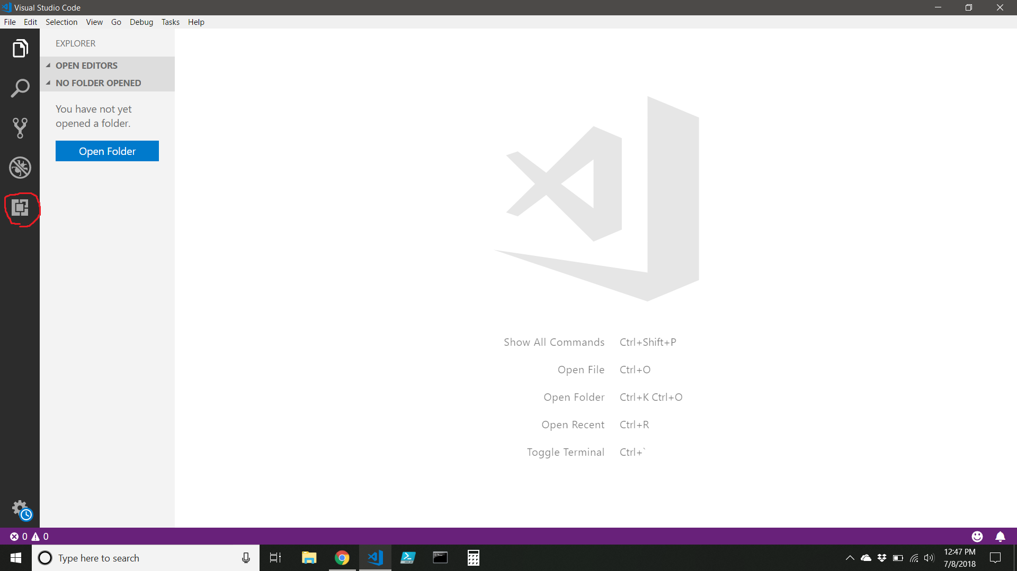
Installing Code Runner

Slide 41
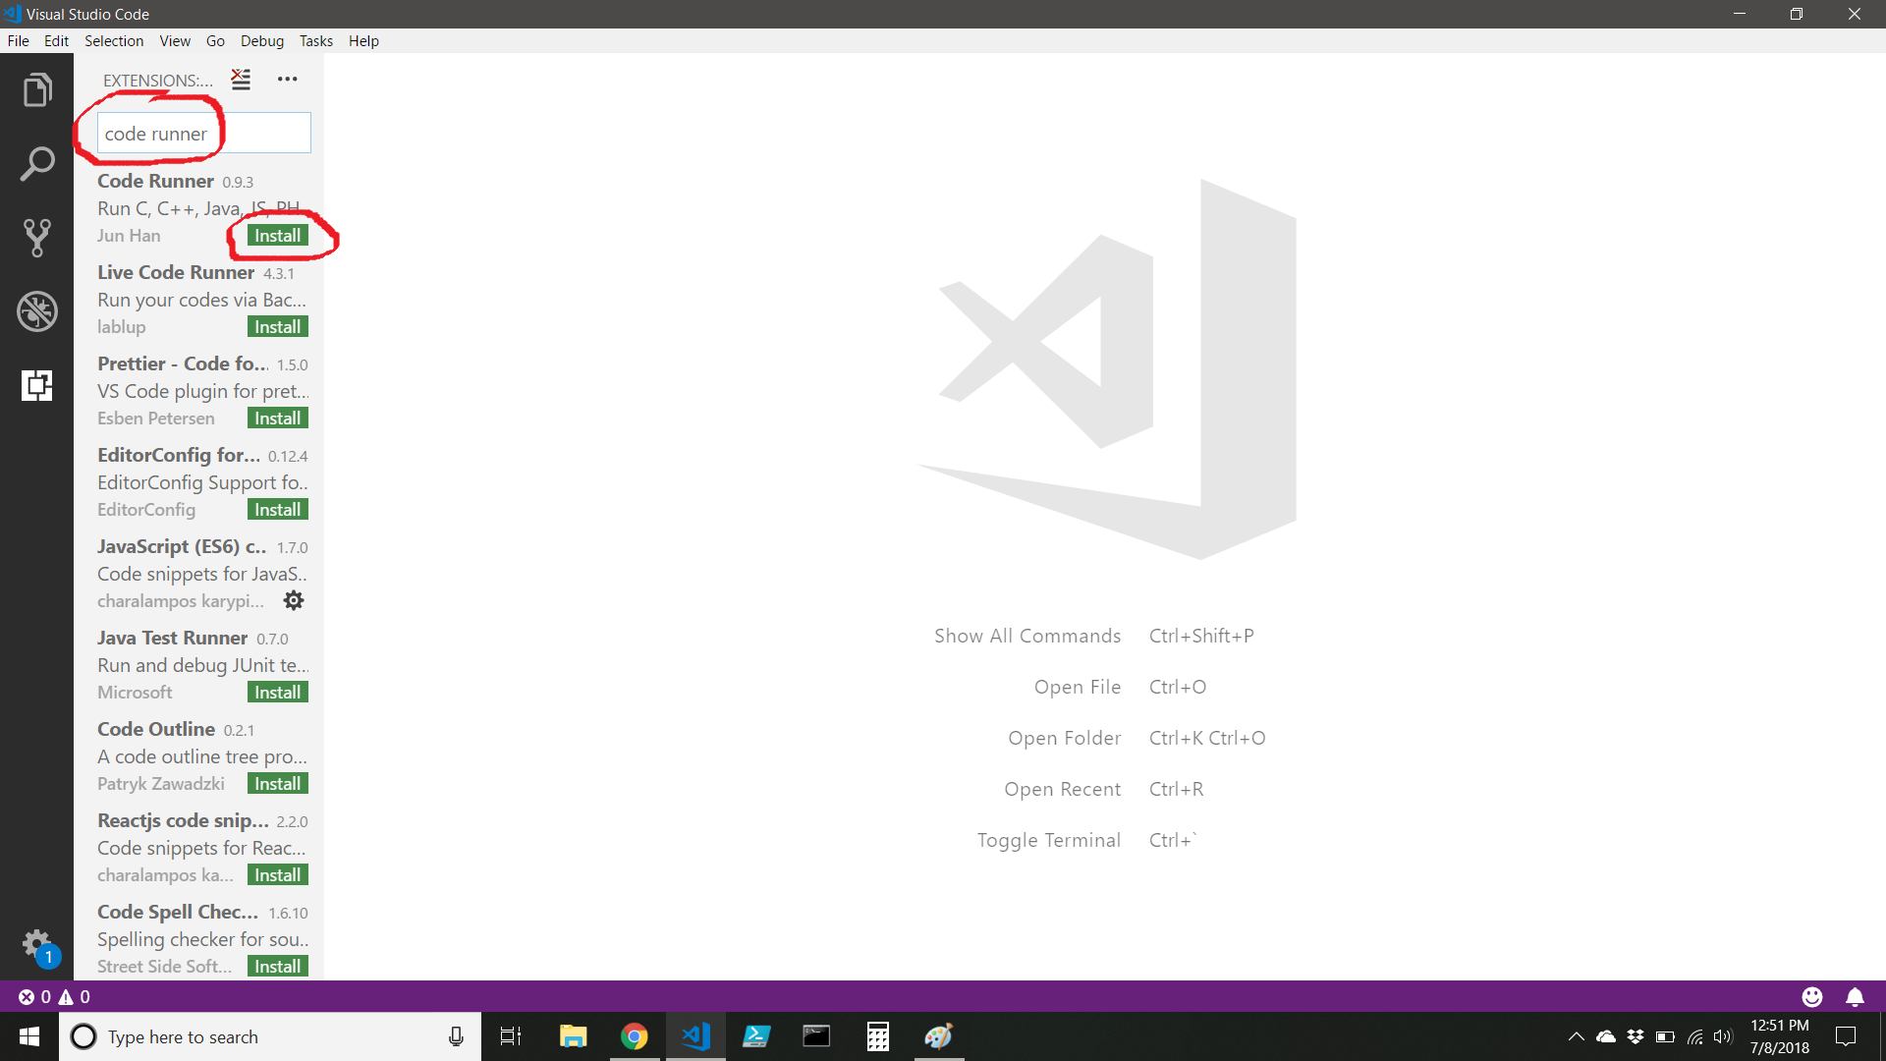
Installing Code Runner (cont)

Slide 42
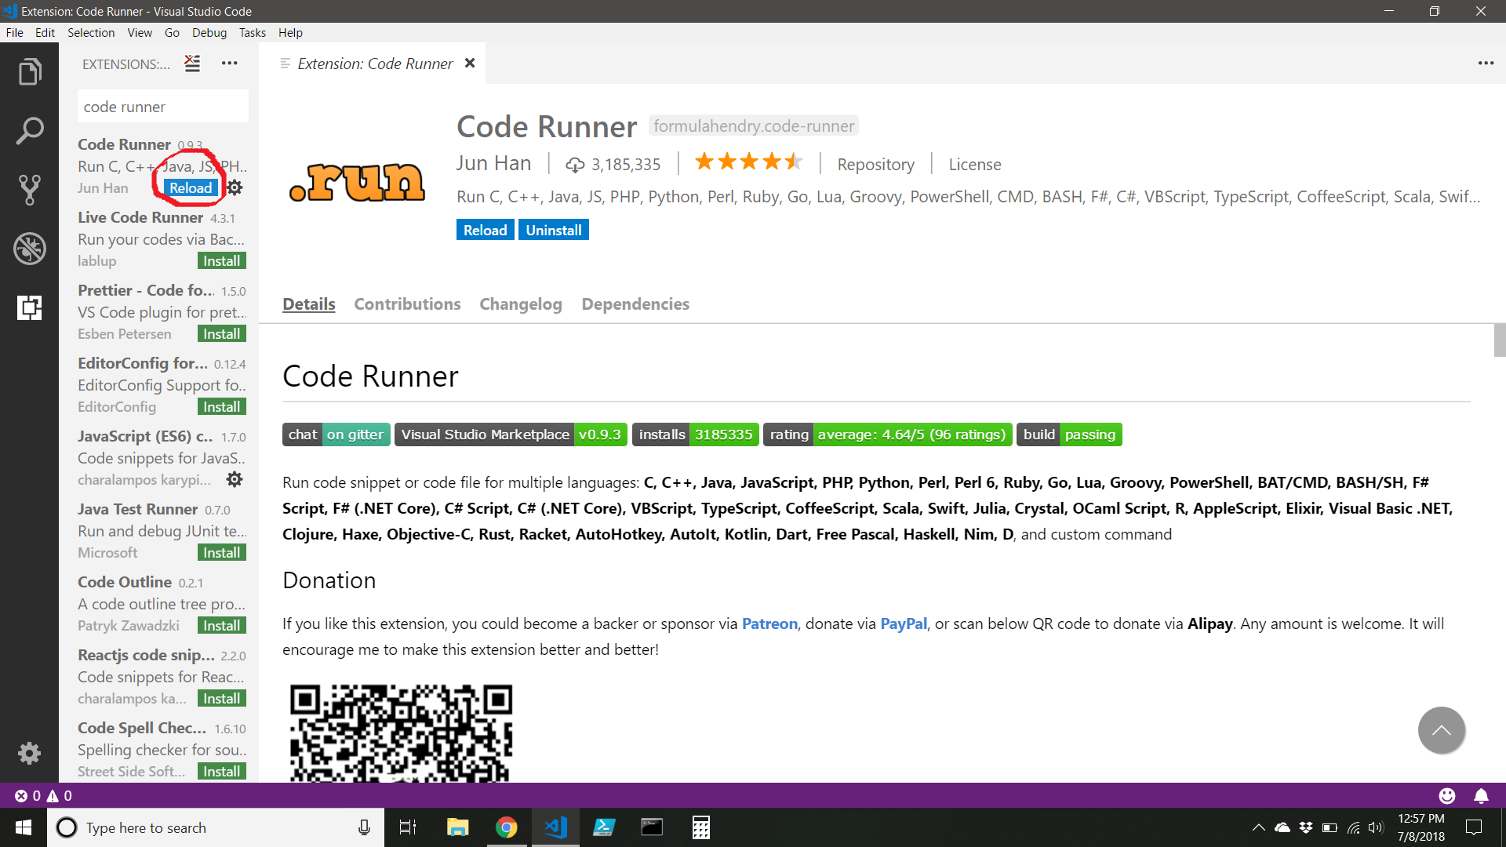
Installing Code Runner (more)

Slide 43
Exercise - Testing Everything
Follow along as we test that everything on our development environments are set up correctly.
Open Visual Studio Code
Create hello-world.html
Open hello-world.html in the Chrome browser
Create hello-world.js
Run hello-world.js using Node and Code Runner
If it all worked, your development environment is set-up and configured!
If something didn’t work, don’t worry we’ll get you set up before you leave.

Slide 44
Review
Today we took our first steps into software engineering.
We met each other
We met the instructors
We learned that coding is hard, and that tenacity is talent
We got connected to the WiFi network, got registered for our attendance tracker, and learned how to check-in for class
We installed, configured, and tested our development environment

Slide 45
What’s Next?
This week we’ll be working on HTML and CSS.
We will learn to create and style static web pages.
Next week we will learn more about HTML and CSS, as well as a handy library called Bootstrap.
After that, we will begin our study of the JavaScript programming language.

Slide 46
Questions?

Slide 47
Code on!

